Slide 1
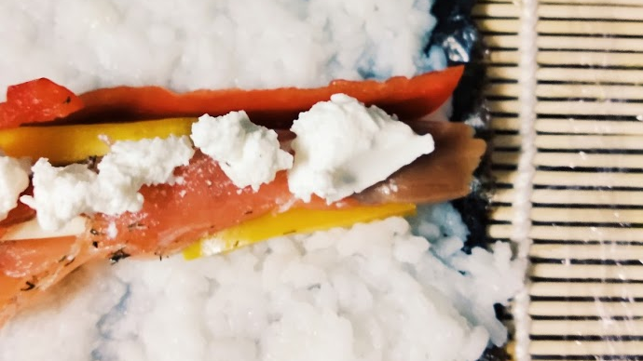
SIEM PROJECT 1 Mockup Submission
Leonor Santos
(up201504515)
5/10/2020

Slide 2
Subject Description

Slide 3
University Student @ the kitchen
As the main theme of this static web page, it was chosen: “University Student @ the kitchen: 101”.
While studying at FEUP, I found myself concerned to maintain balanced and nourishing eating habits, which I must promptly conciliate with my academic and personal life.
This subject provides content to build the HTML and CSS code which altogether will result in a web site and its static pages.

Slide 4
Colors

Slide 5
Color palette
#865336 | #CB997E | #DDBEA9 | #FFE8D6 | #B7B7A4 | #A5A58D | #6B705C

Slide 6
Page info

Slide 7
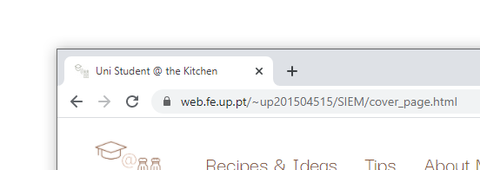
Web Page Info
Site logo as tab icon
Shortened title to fit space

Slide 8
Navbar

Slide 9
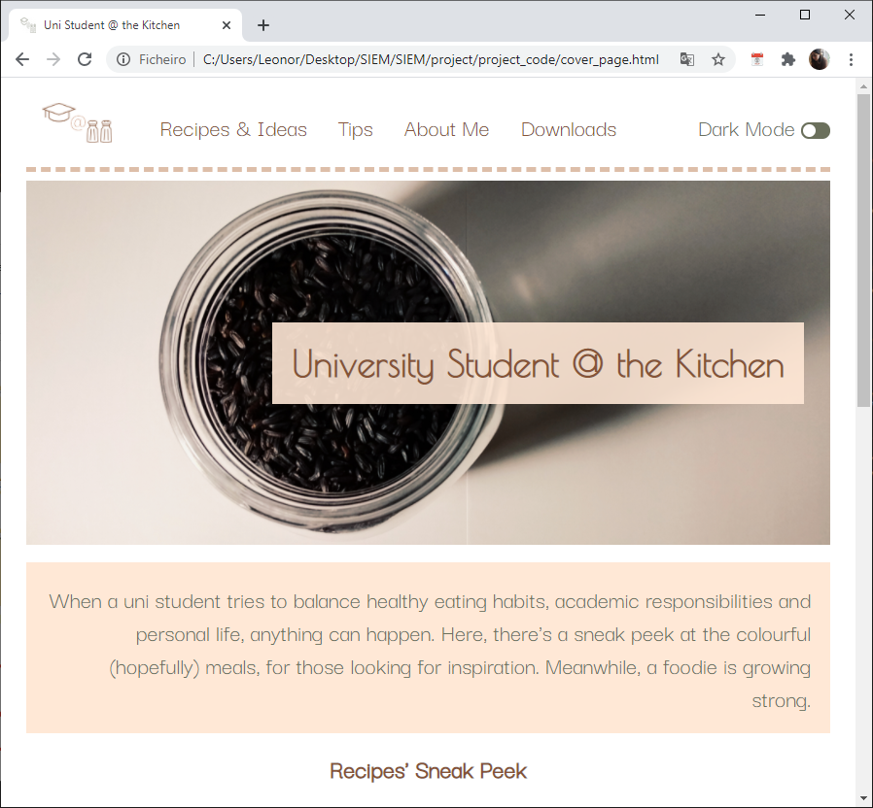

Navbar -elements
Links to other pages
Margin: 2vw
Background: white
Logo, link to homepage, changes color when hovering
border-bottom:
#DDBEA9
5px
dashed
align: left;
padding left/right: 16px;
font: Darker Grotesque;
font size: adapts to width and height (in the range 10px-25px)
Color: #865336

Slide 10
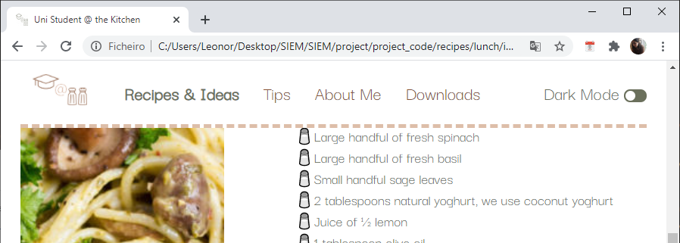
Navbar - behaviour (I)
Navbar sticky at the top
Current page: emphasized and #6B705C

Slide 11
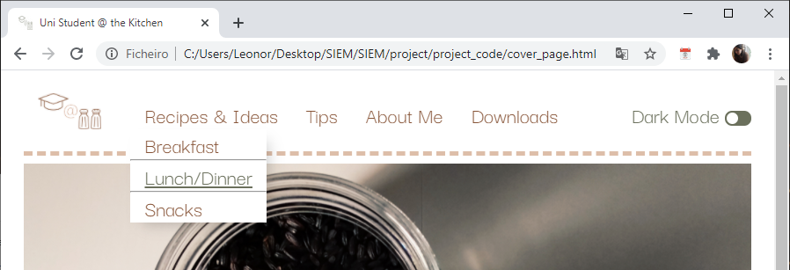
Navbar - behaviour (II)
Drop Down menu:
Breakfast
Lunch/dinner
Snacks
Shadow at right and bottom
Underline when hovering
Color: #6B705C

Slide 12
Cover Page

Slide 13
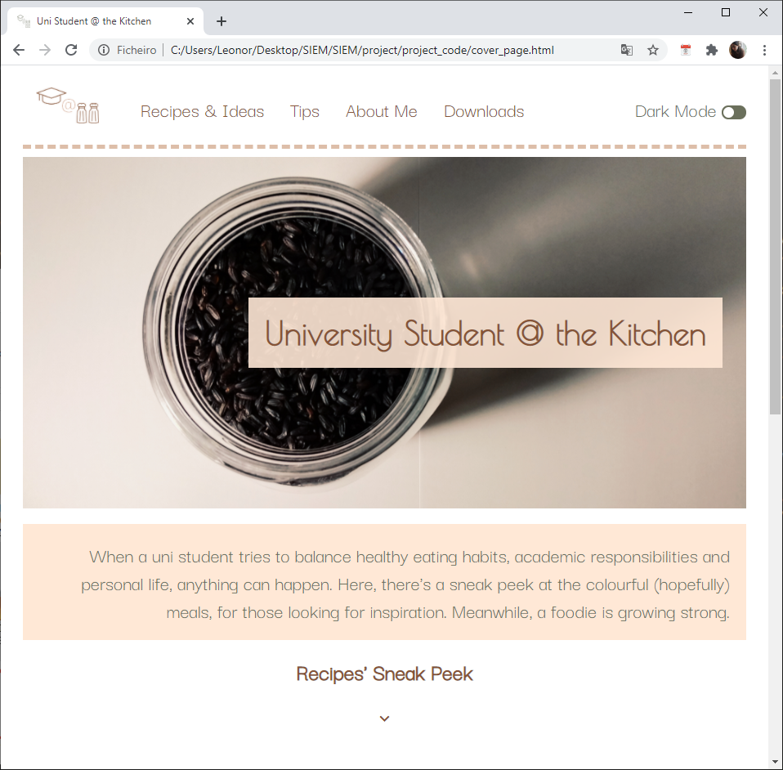
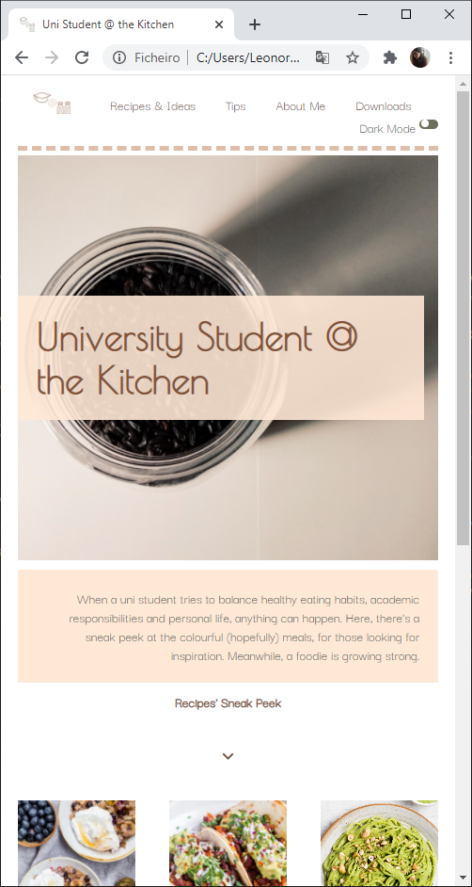
Overview

Slide 14
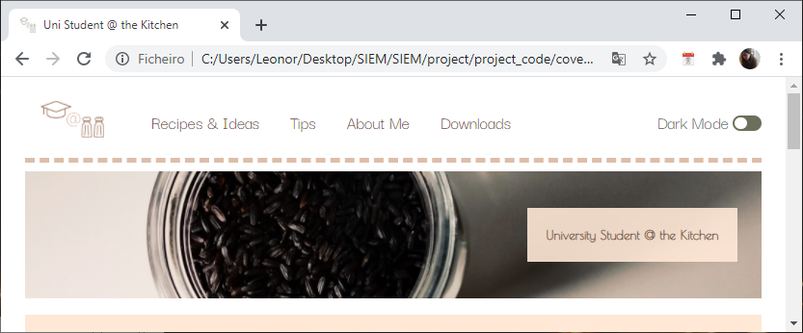
Responsive Behaviour
Contents resize to width and height

Slide 15

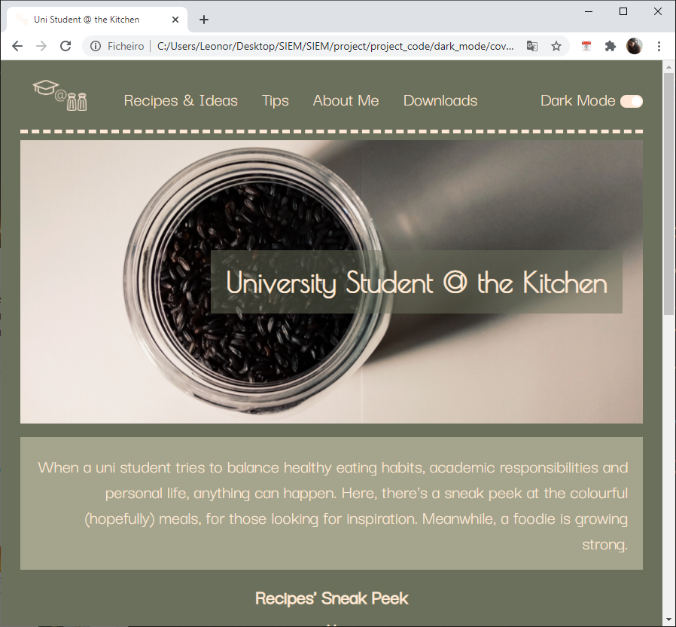
Dark Mode Option
Check slider to change mode

Slide 16
Fonts, Widths, Margins and Paddings (I)
Image over text
color: #865336;
background:FFE8D6
background opacity: 90%
font-family: Poiret One;
margin-right: 3vw;
padding: 20px;
font-size: adjustable, max 40px
color: #6B705C;
Background: FE8D6
align: right;
font: Darker Grotesque;
font-size: adjustable, min 10px, max 25px
padding: 20px;

Slide 17
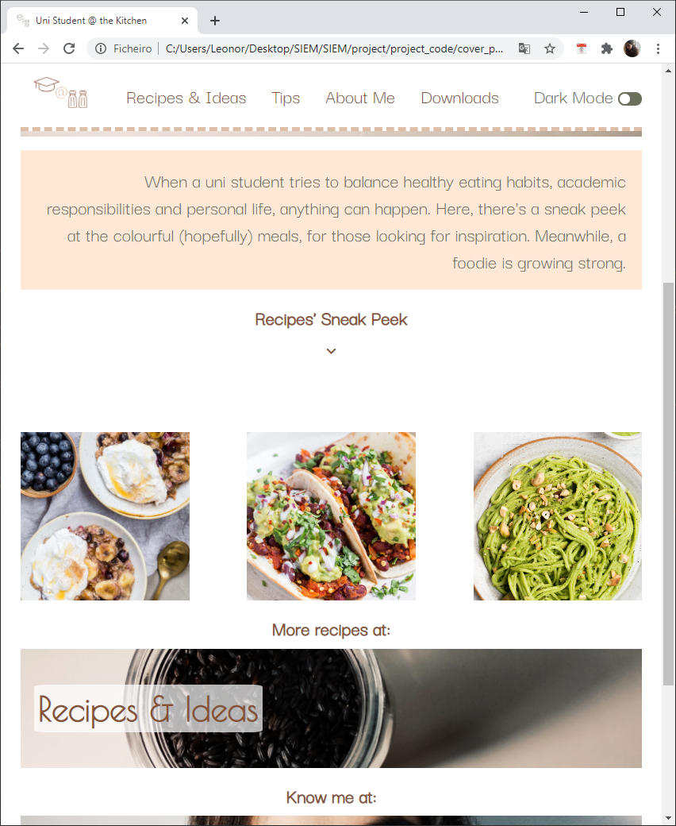
Fonts, Widths, Margins and Paddings (II)
Image over text
color: #865336;
background: white
font-family: Darker Grotesque;
margin: auto to center in page;;
font-size: adjustable, min10 px; max-40px
Icon
Link to bookmark; pointing to images below
Color:#865336
Animation up and down
Sequence of 3xImage
width: 25vw;
height: 25vw;
Animation fading
Animation duration: 12s; 4s showing 1 image; 1s fading between images;

Slide 18
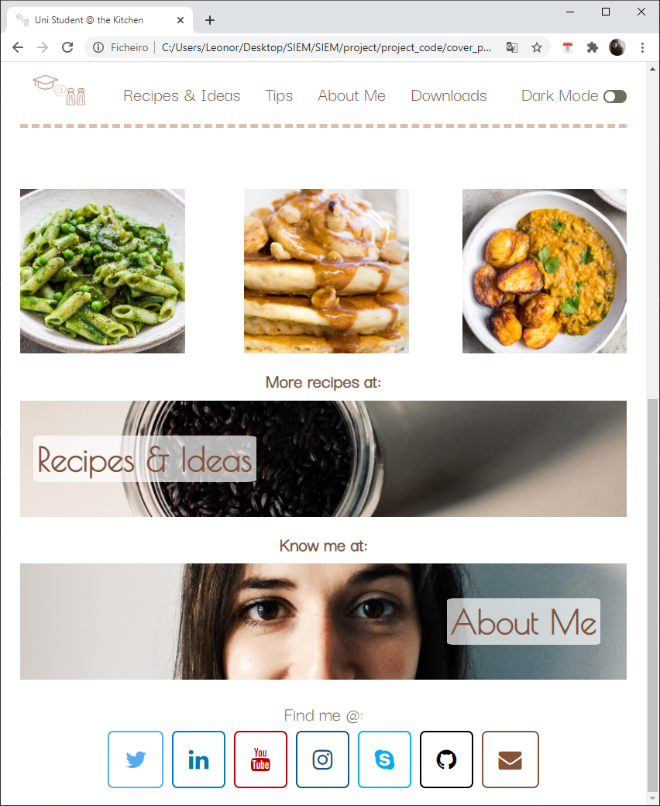
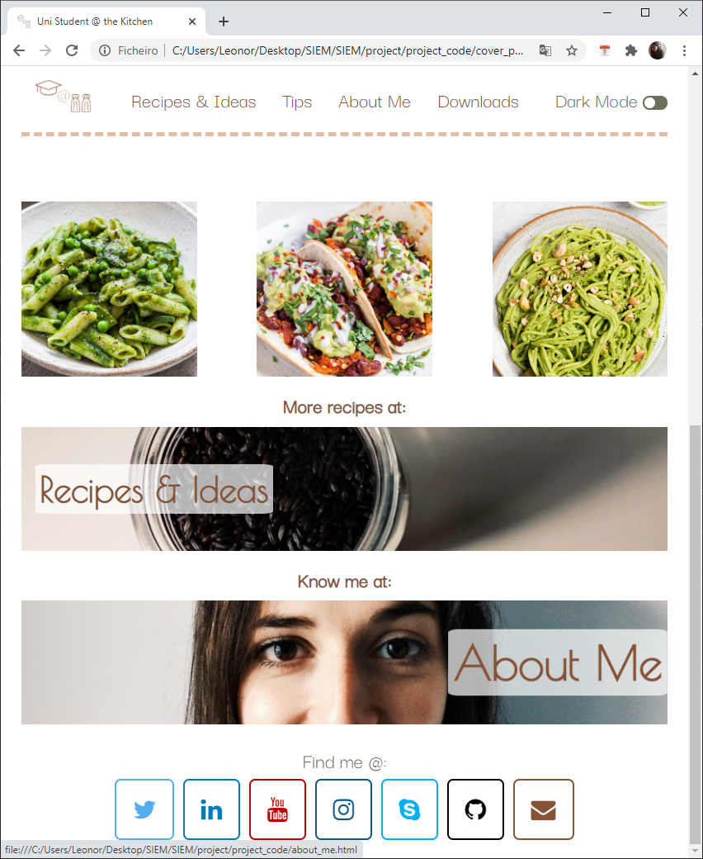
Fonts, Widths, Margins and Paddings (III)
Image
margin-top: 1vw;
height: adjustable, min: 30px max: 400px;
Link to page
Tab title
color: #865336;
font-family: Darker Grotesque;
font-size: adjustable; min 30px; max 10px;
Animation: zoom on hover
Links to social media
Background: white
Icon and border: respective color
Padding: 20px

Slide 19
Fonts, Widths, Margins and Paddings (III)
Image
margin-top: 1vw;
height: adjustable, min: 30px max: 400px;
Link to page
Tab title
color: #865336;
font-family: Darker Grotesque;
font-size: adjustable; min 30px; max 10px;
Animation: zoom on hover
Links to social media
Background: white
Icon and border: respective color
Padding: 20px

Slide 20
Cover Page- Dark Mode

Slide 21
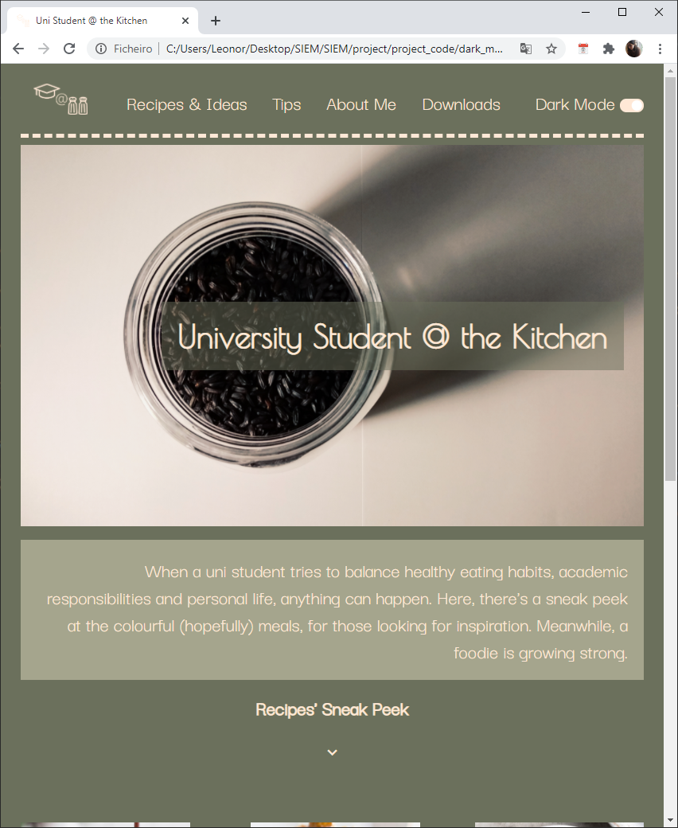
Fonts, Widths, Margins and Paddings (III)
Text and border color: #FFE8D6
color: #FFE8D6;
background: #706B7C
opacity: 50%
color: #FFE8D6;
background-color: #A5A58D;

Slide 22
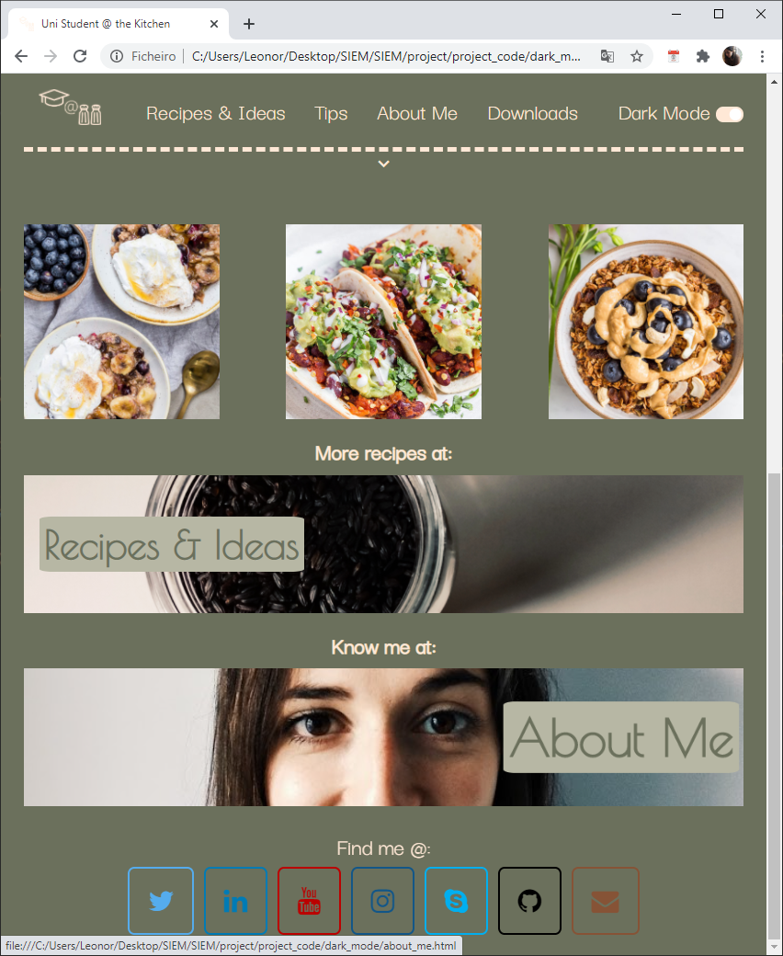
Fonts, Widths, Margins and Paddings (III)
Different logo
color: #6B705C;
background-color: #B7B7A4;

Slide 23
Recipes and Ideas Pages

Slide 24
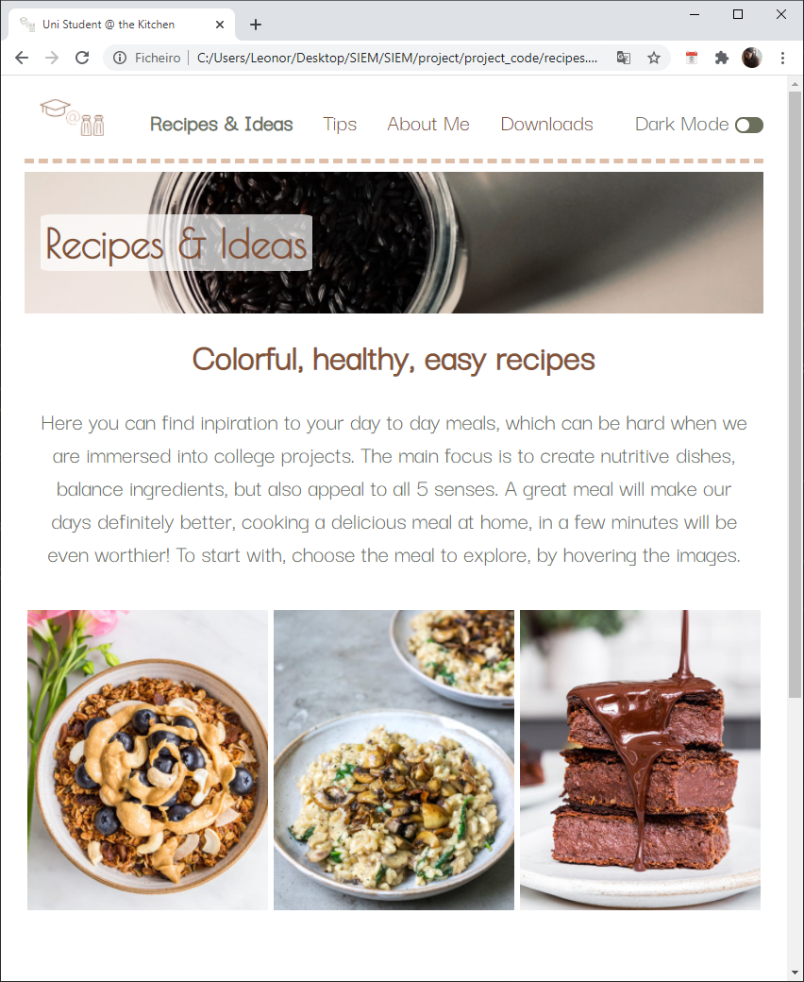
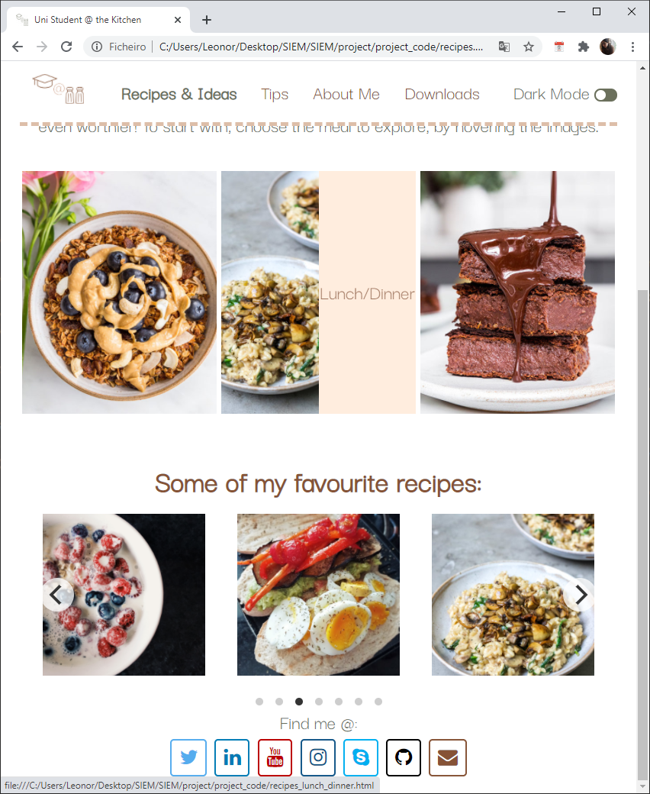
Overview

Slide 25
Fonts, Widths, Margins and Paddings (I)
Current section emphasized
Same properties as cover page
color: #865336;
font-family: Darker Grotesque;
font-size: adjustable; min 15px; max 40px;
padding: 0;
margin: auto;
width: 100%;
color: #6B705C;
font-family: Darker Grotesque;
font-size: adjustable; min 10px; max 30px;

Slide 26
Fonts, Widths, Margins and Paddings (II)
Link to pages
width: adjustable to 30% vw; max: 400px; min 200px;
Image covering square;
Text:
Background #FFE8D6; opacity: 0.8;
color: #865336;
text-align: center;
font: Darker Grotesque;
font-size: adjustable; min 10px; max 30px;
Animation: texto background grows when hovering
Carousel showing fav recipes;
Automatically rotates
Uses cards as above

Slide 27
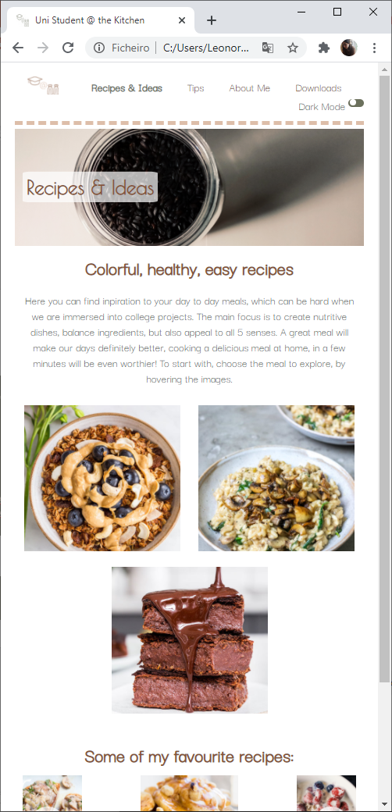
Behaviour
Adjustable card positioning

Slide 28
Breakfast, Lunch and Snacks Pages

Slide 29
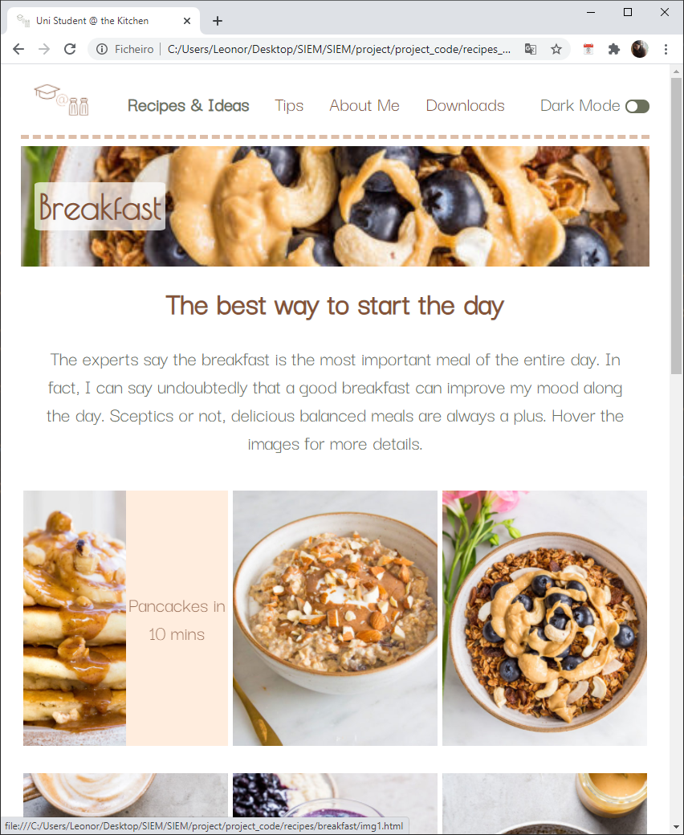
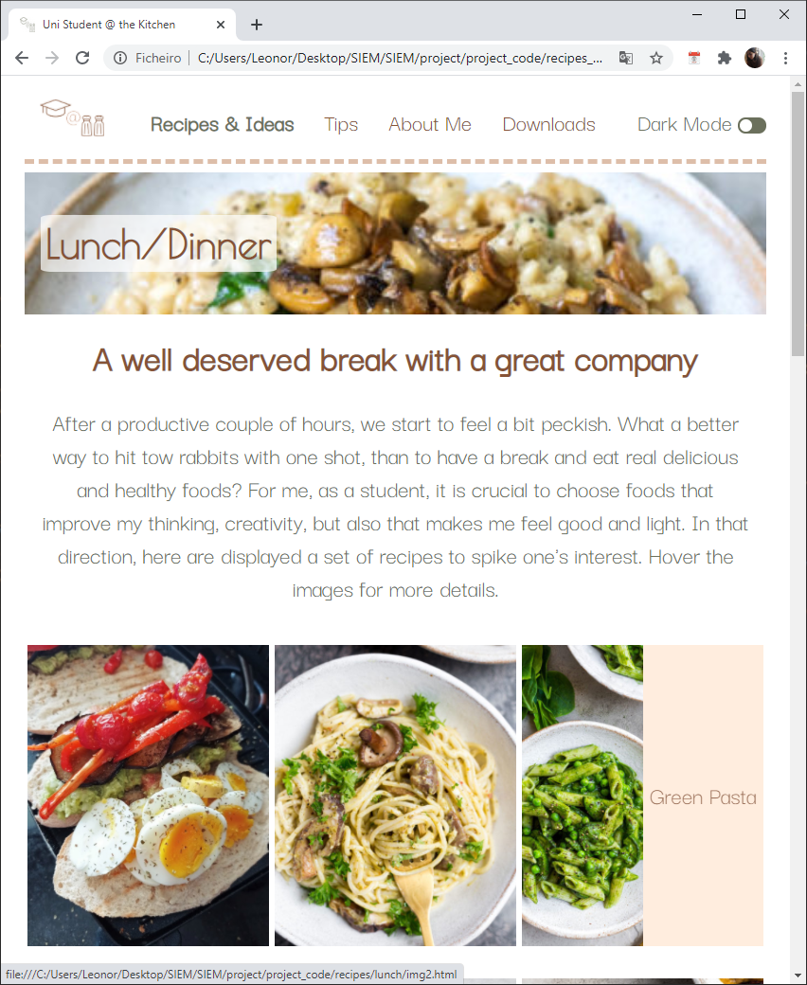
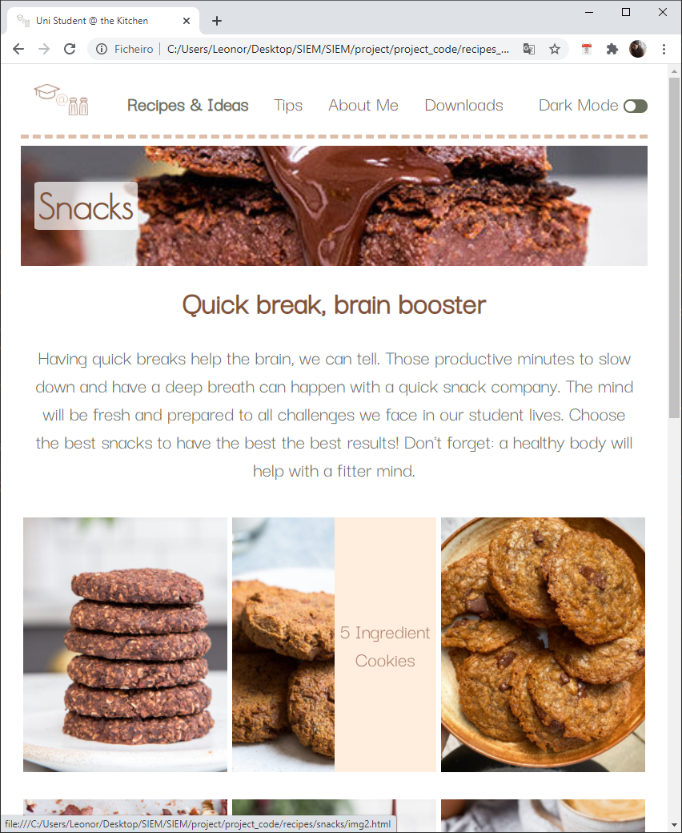
Overview

Slide 30
Fonts, Widths, Margins and Paddings (I)
Same properties as cover page
Same properties as “Recipes & Ideas”
Cards as previously;
link to each recipe

Slide 31
Breakfast, Lunch and Snacks Pages

Slide 32
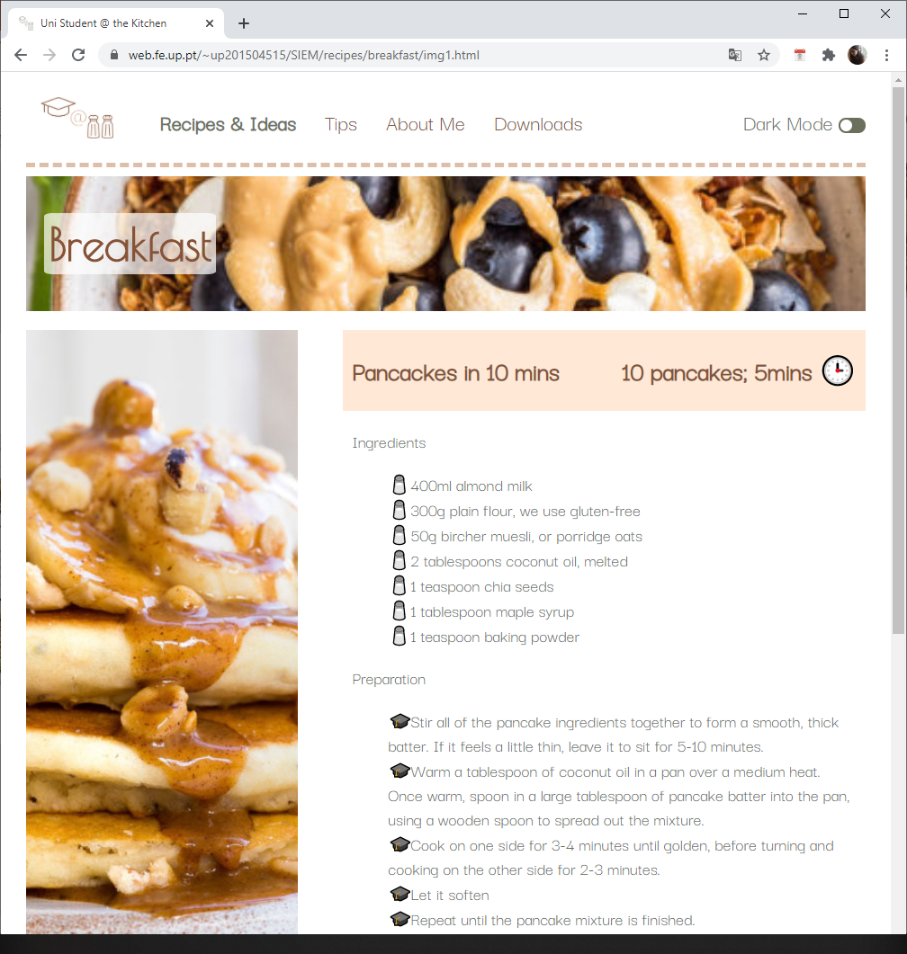
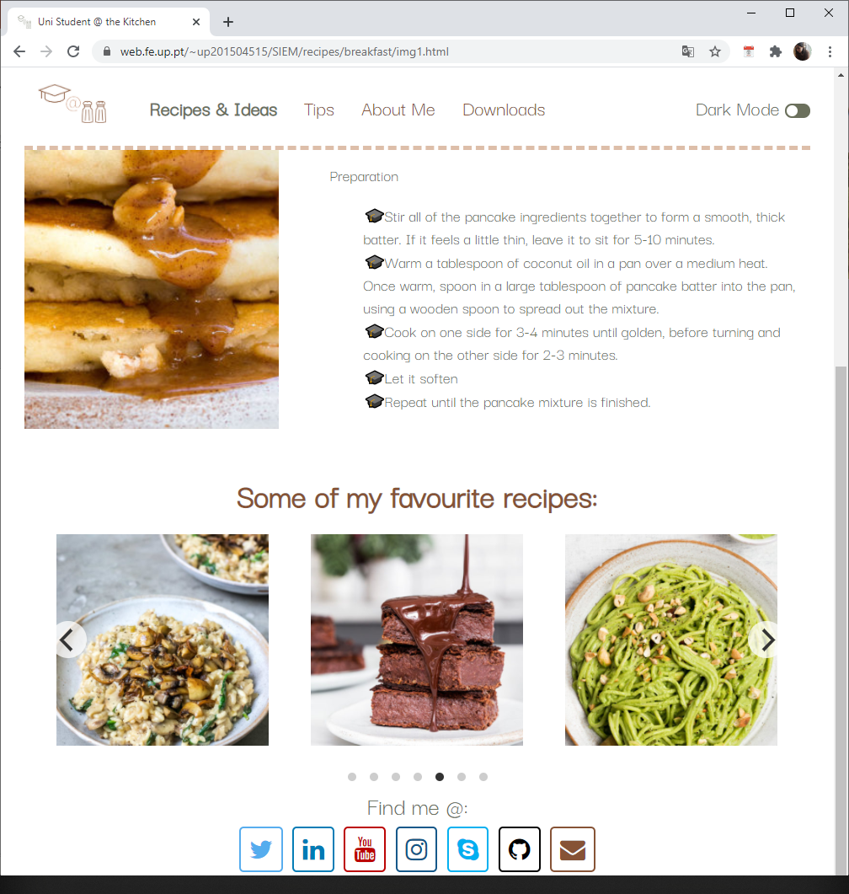
Overview

Slide 33
Fonts, Widths, Margins and Paddings (I)
Same properties as cover page
Same properties as “Recipes & Ideas”
Cards as previously;
link to each recipe

Slide 34
Tips Page

Slide 35
About Me Page

Slide 36
Downloads

